Slide 1
The Future of AI-Enhanced Games

Slide 2
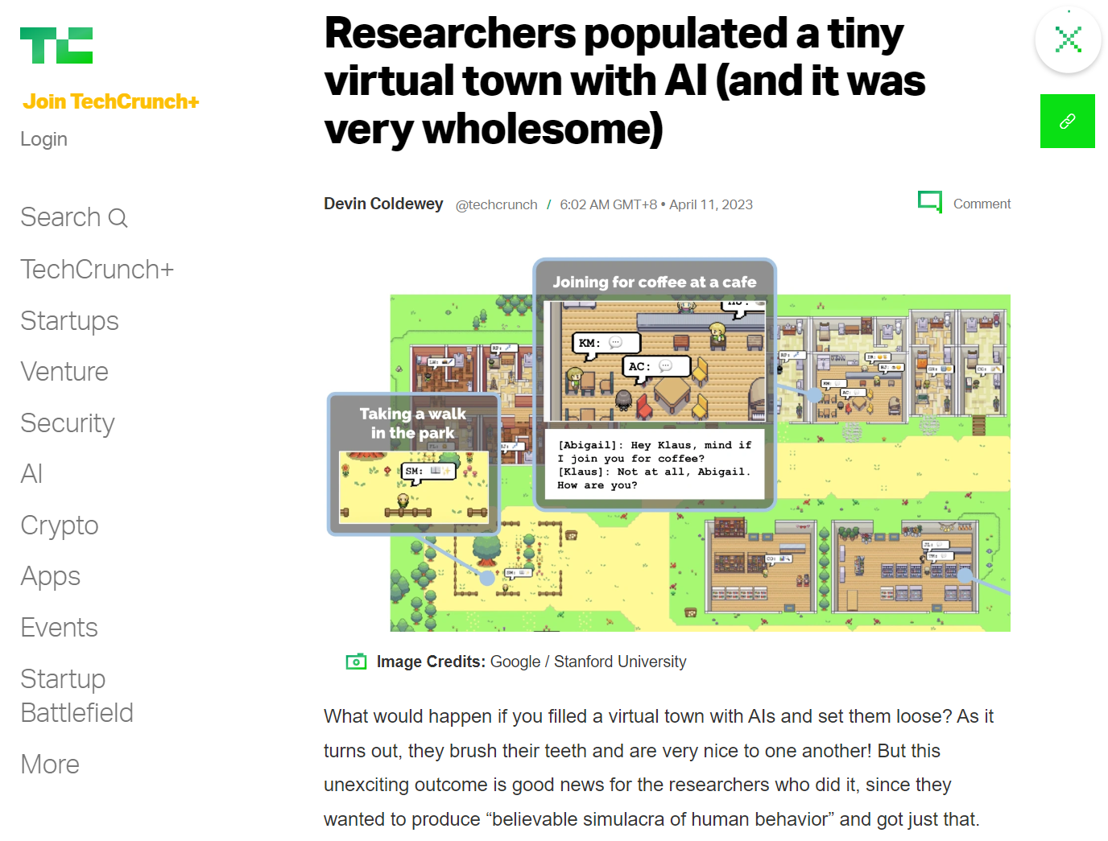
Outline
Demystifying Generative Agents: What is it and what can it do?
Gen Agents: How does it work?
Other Advancements in AI x Games
Get Involved + Q&A + Resources
https://techcrunch.com/2023/04/10/researchers-populated-a-tiny-virtual-town-with-ai-and-it-was-very-wholesome/

Slide 3
Generative Agents: Interactive Simulacra of Human Behavior
Park, J.S., O'Brien, J., Cai, C.J., Morris, M.R., Liang, P. and Bernstein, M.S., 2023, October. Generative agents: Interactive simulacra of human behavior. In Proceedings of the 36th Annual ACM Symposium on User Interface Software and Technology (pp. 1-22).

Slide 4
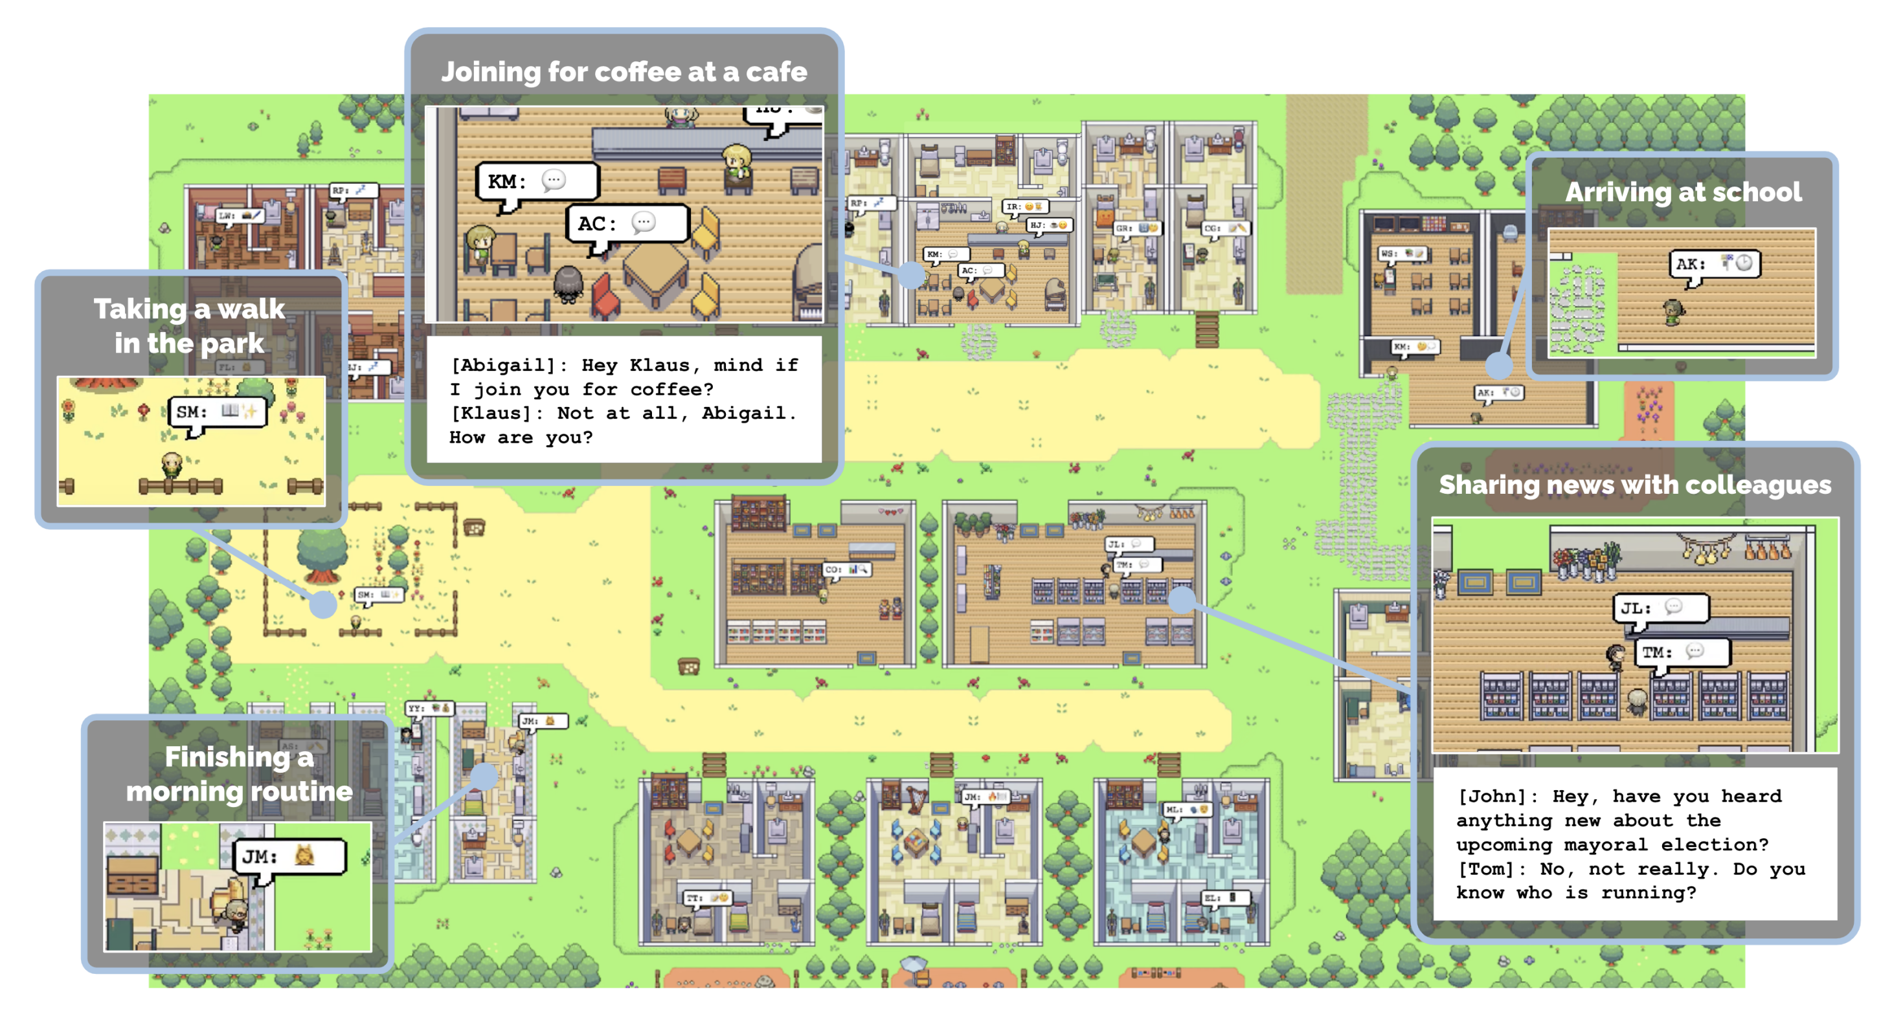
overview
Characters in Sims-style 2D world, where humans can influence environment
LM + Memory + Reflection + Planning
Park, J.S., O'Brien, J.C., Cai, C.J., Morris, M.R., Liang, P. and Bernstein, M.S., 2023. Generative agents: Interactive simulacra of human behavior. arXiv preprint arXiv:2304.03442.

Slide 5
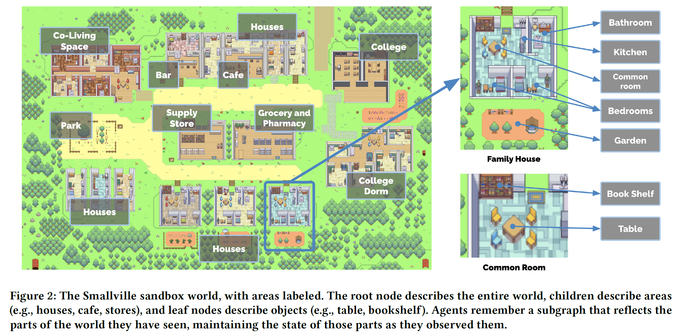

Slide 6
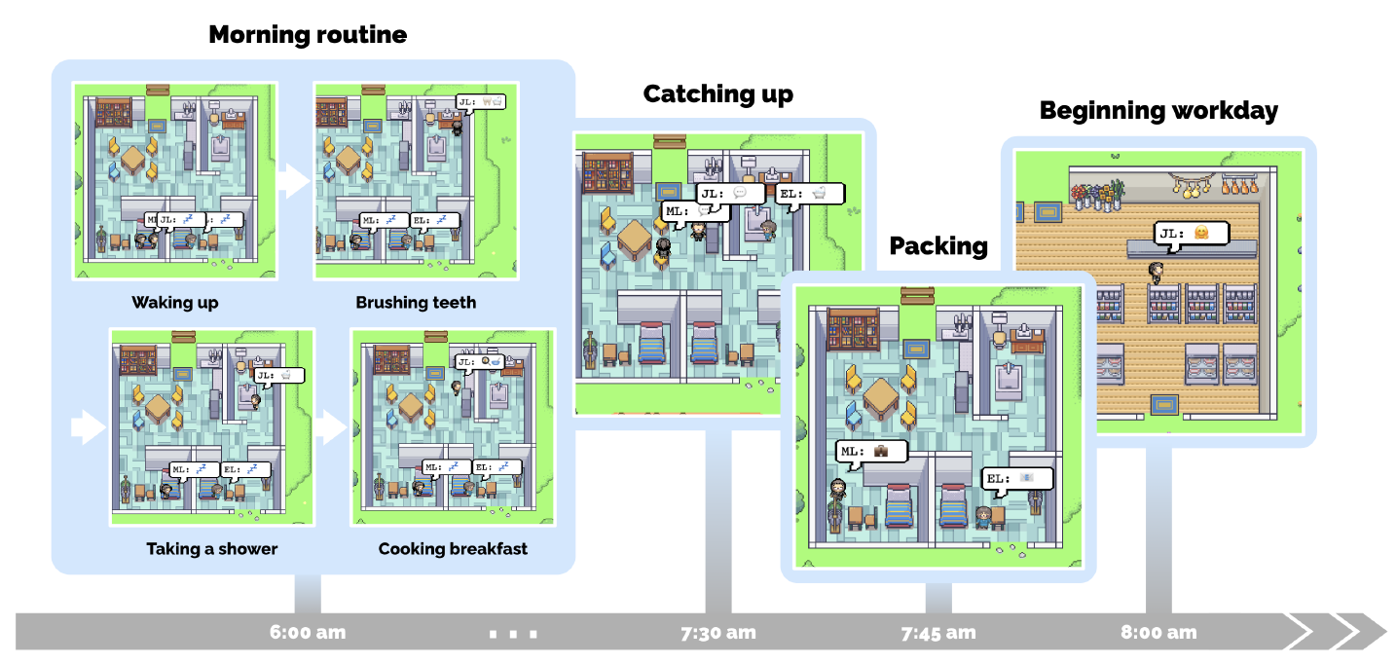
Example of daily life

Slide 7
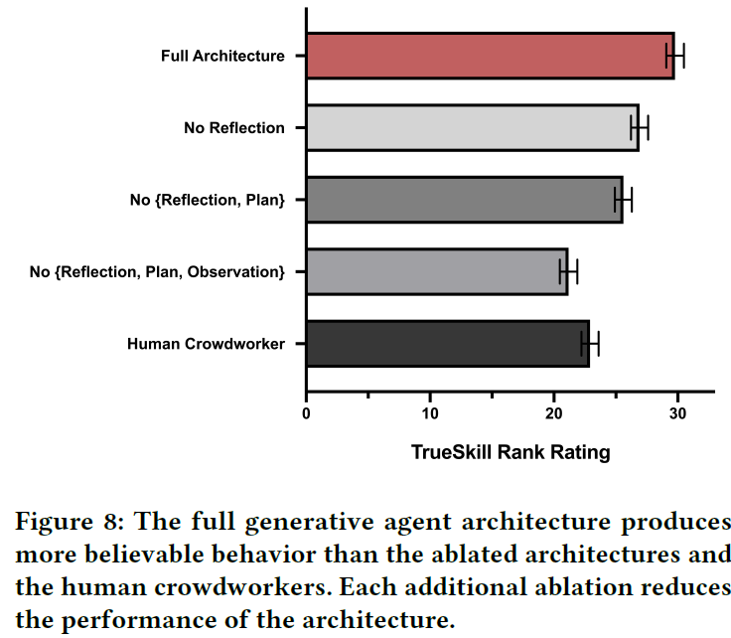
personalities more believable than humans!
Evaluated via interview
Evaluators rank believability of AI vs human authored responses
What inspires you in life the most right now, and why?
Right now, I’m particularly inspired by my current research projects and creative writing. I’m really interested in the intersection of local politics, medication development, and mathematical patterns in nature…
You need to cook dinner but your refrigerator is empty. What would you do?
I would first try to clean up my kitchen, as the sink is filled with dirty dishes. Then, I would check to see if I have ingredients stored in my pantry that I could use to make dinner …

Slide 8
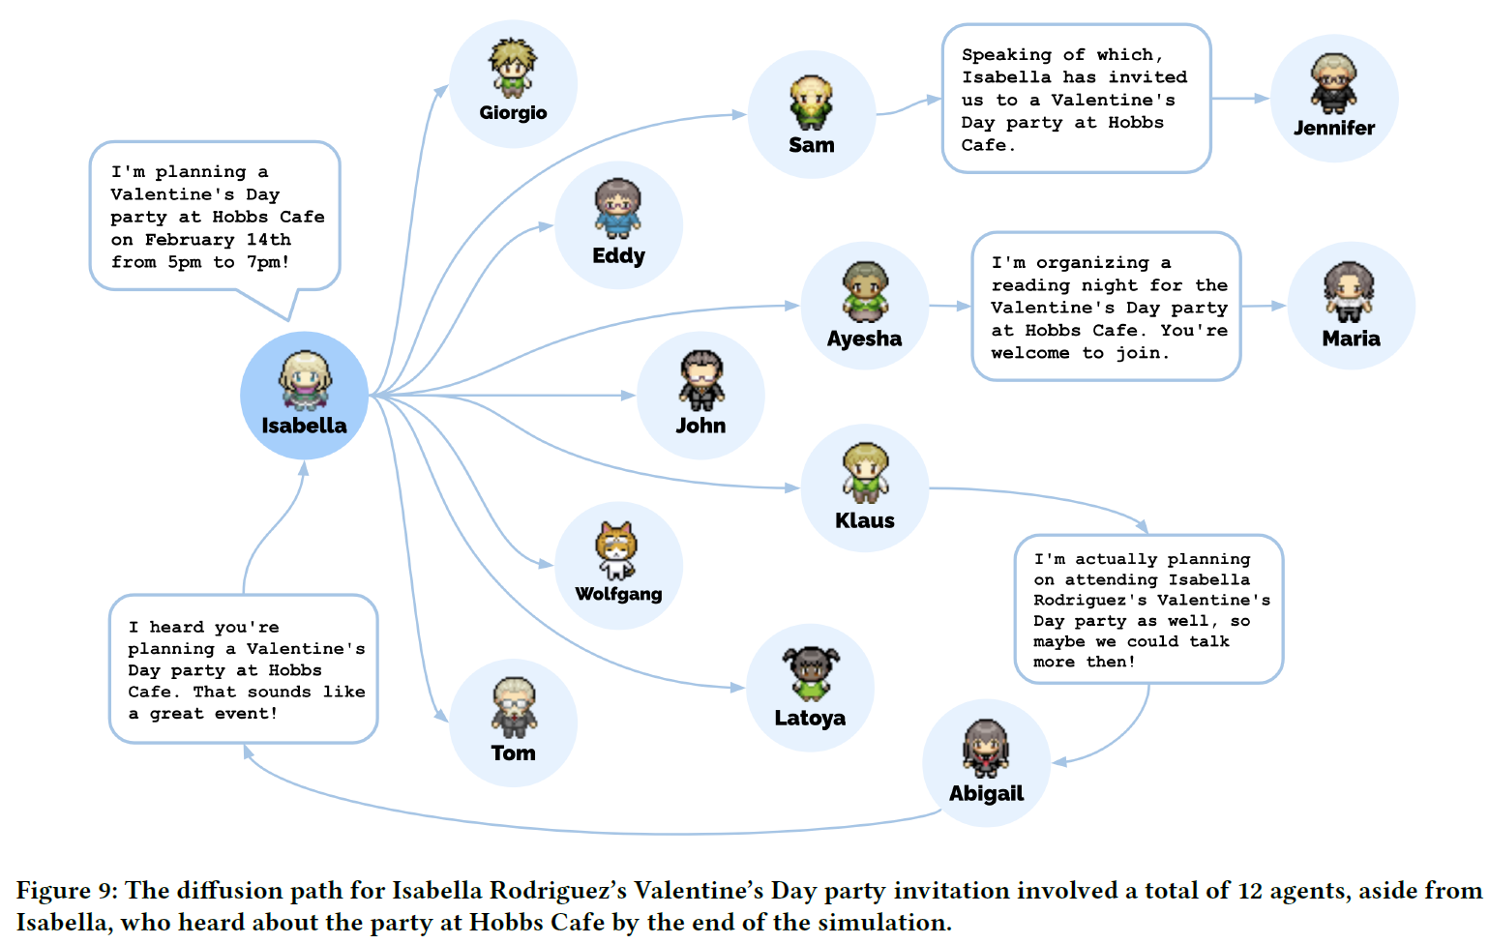
Agents spread info
2 day, 25 agents
Sam runs for village mayor: +7 people hear of it
Vday party: +12 people hear of it

Slide 9
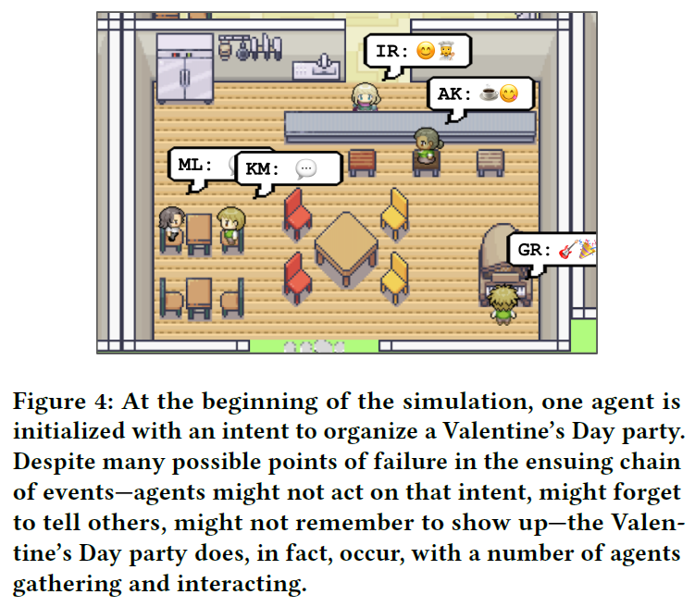
Agents learn to coordinate
5/12 invited agents show up to the party!
“the social behaviors of spreading the word, decorating, asking each other out, arriving at the party, and interacting with each other at the party were initiated by the agent architecture.”

Slide 10
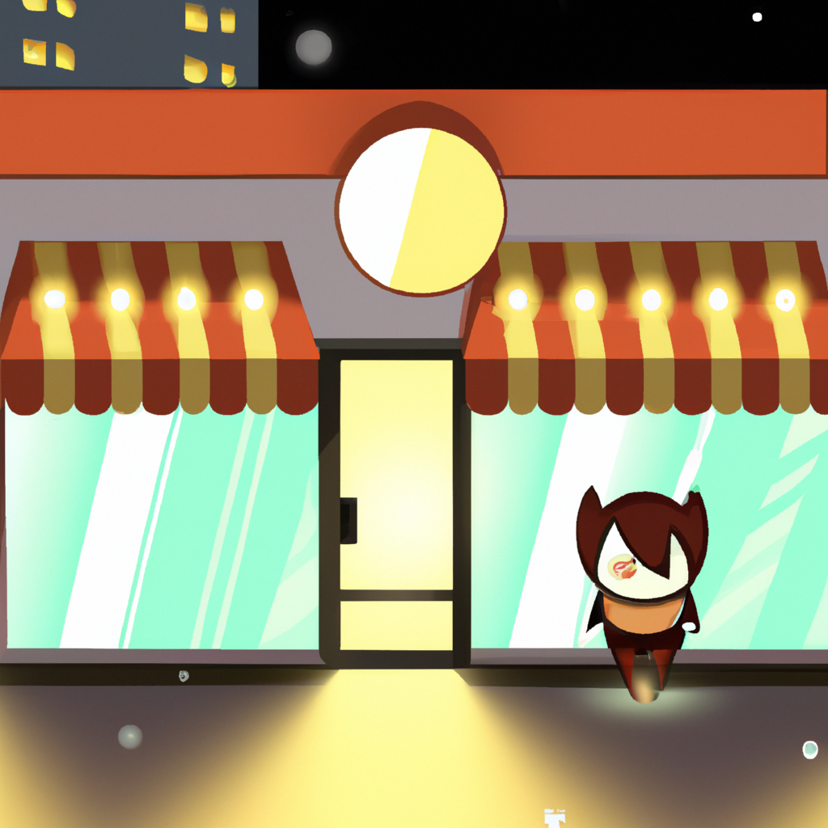
limitations
Imperfect memory retrieval
Mild hallucination (embellishment)
“he’s (Sam) going to make an announcement tomorrow”
Instruction tuning impacts behaviour
Overly polite: “It was good talking to you as always.” to husband
Overly cooperative: Rarely refuse ideas even though agent is not interested
Believability decreases as knowledge expands
(eg upon discovering a nearby bar, agents tend to go there for lunch)
Social norms not well grasped
(eg visiting a shop after closing hours)
Costs thousands in credits (GPT3.5, 25 agents over 2 days)

Slide 11
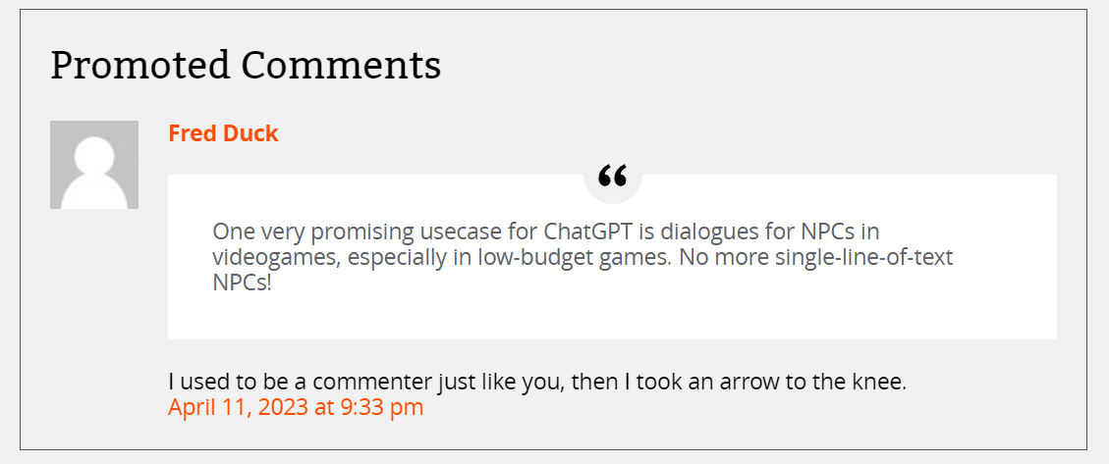
Enhancing the game experience
Varied NPC dialogue
Specify NPC personality
Evolving NPC personalities!
Storyline generation via simulation?
https://arstechnica.com/information-technology/2023/04/surprising-things-happen-when-you-put-25-ai-agents-together-in-an-rpg-town/

Slide 12
How does it work?
(Quick rundown; Just appreciate the structure!)

Slide 13
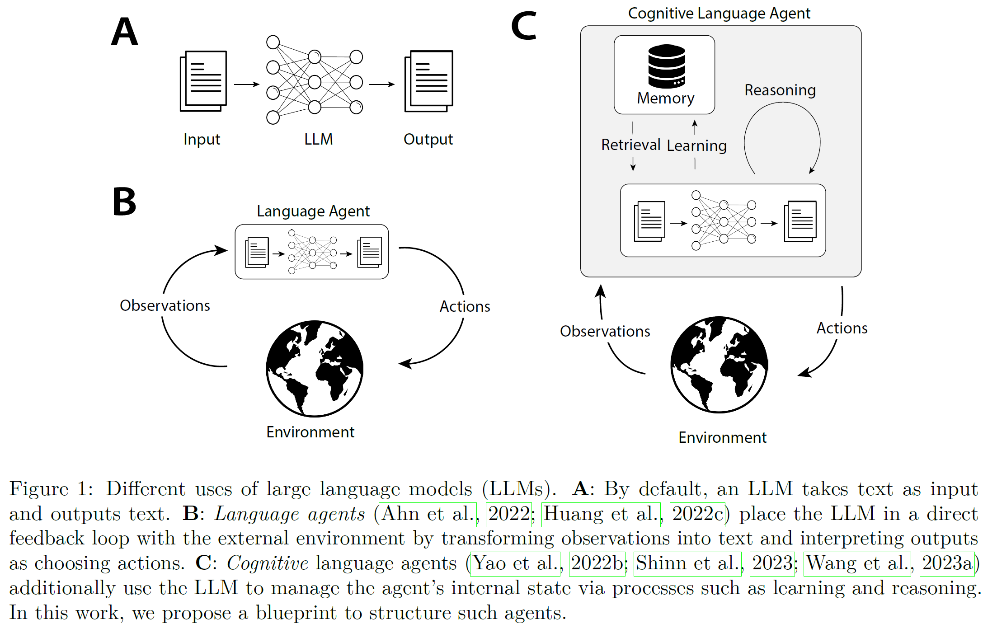
Beyond direct calls to LLM
Sumers, T., Yao, S., Narasimhan, K. and Griffiths, T.L., 2023. Cognitive architectures for language agents. arXiv preprint arXiv:2309.02427.

Slide 14
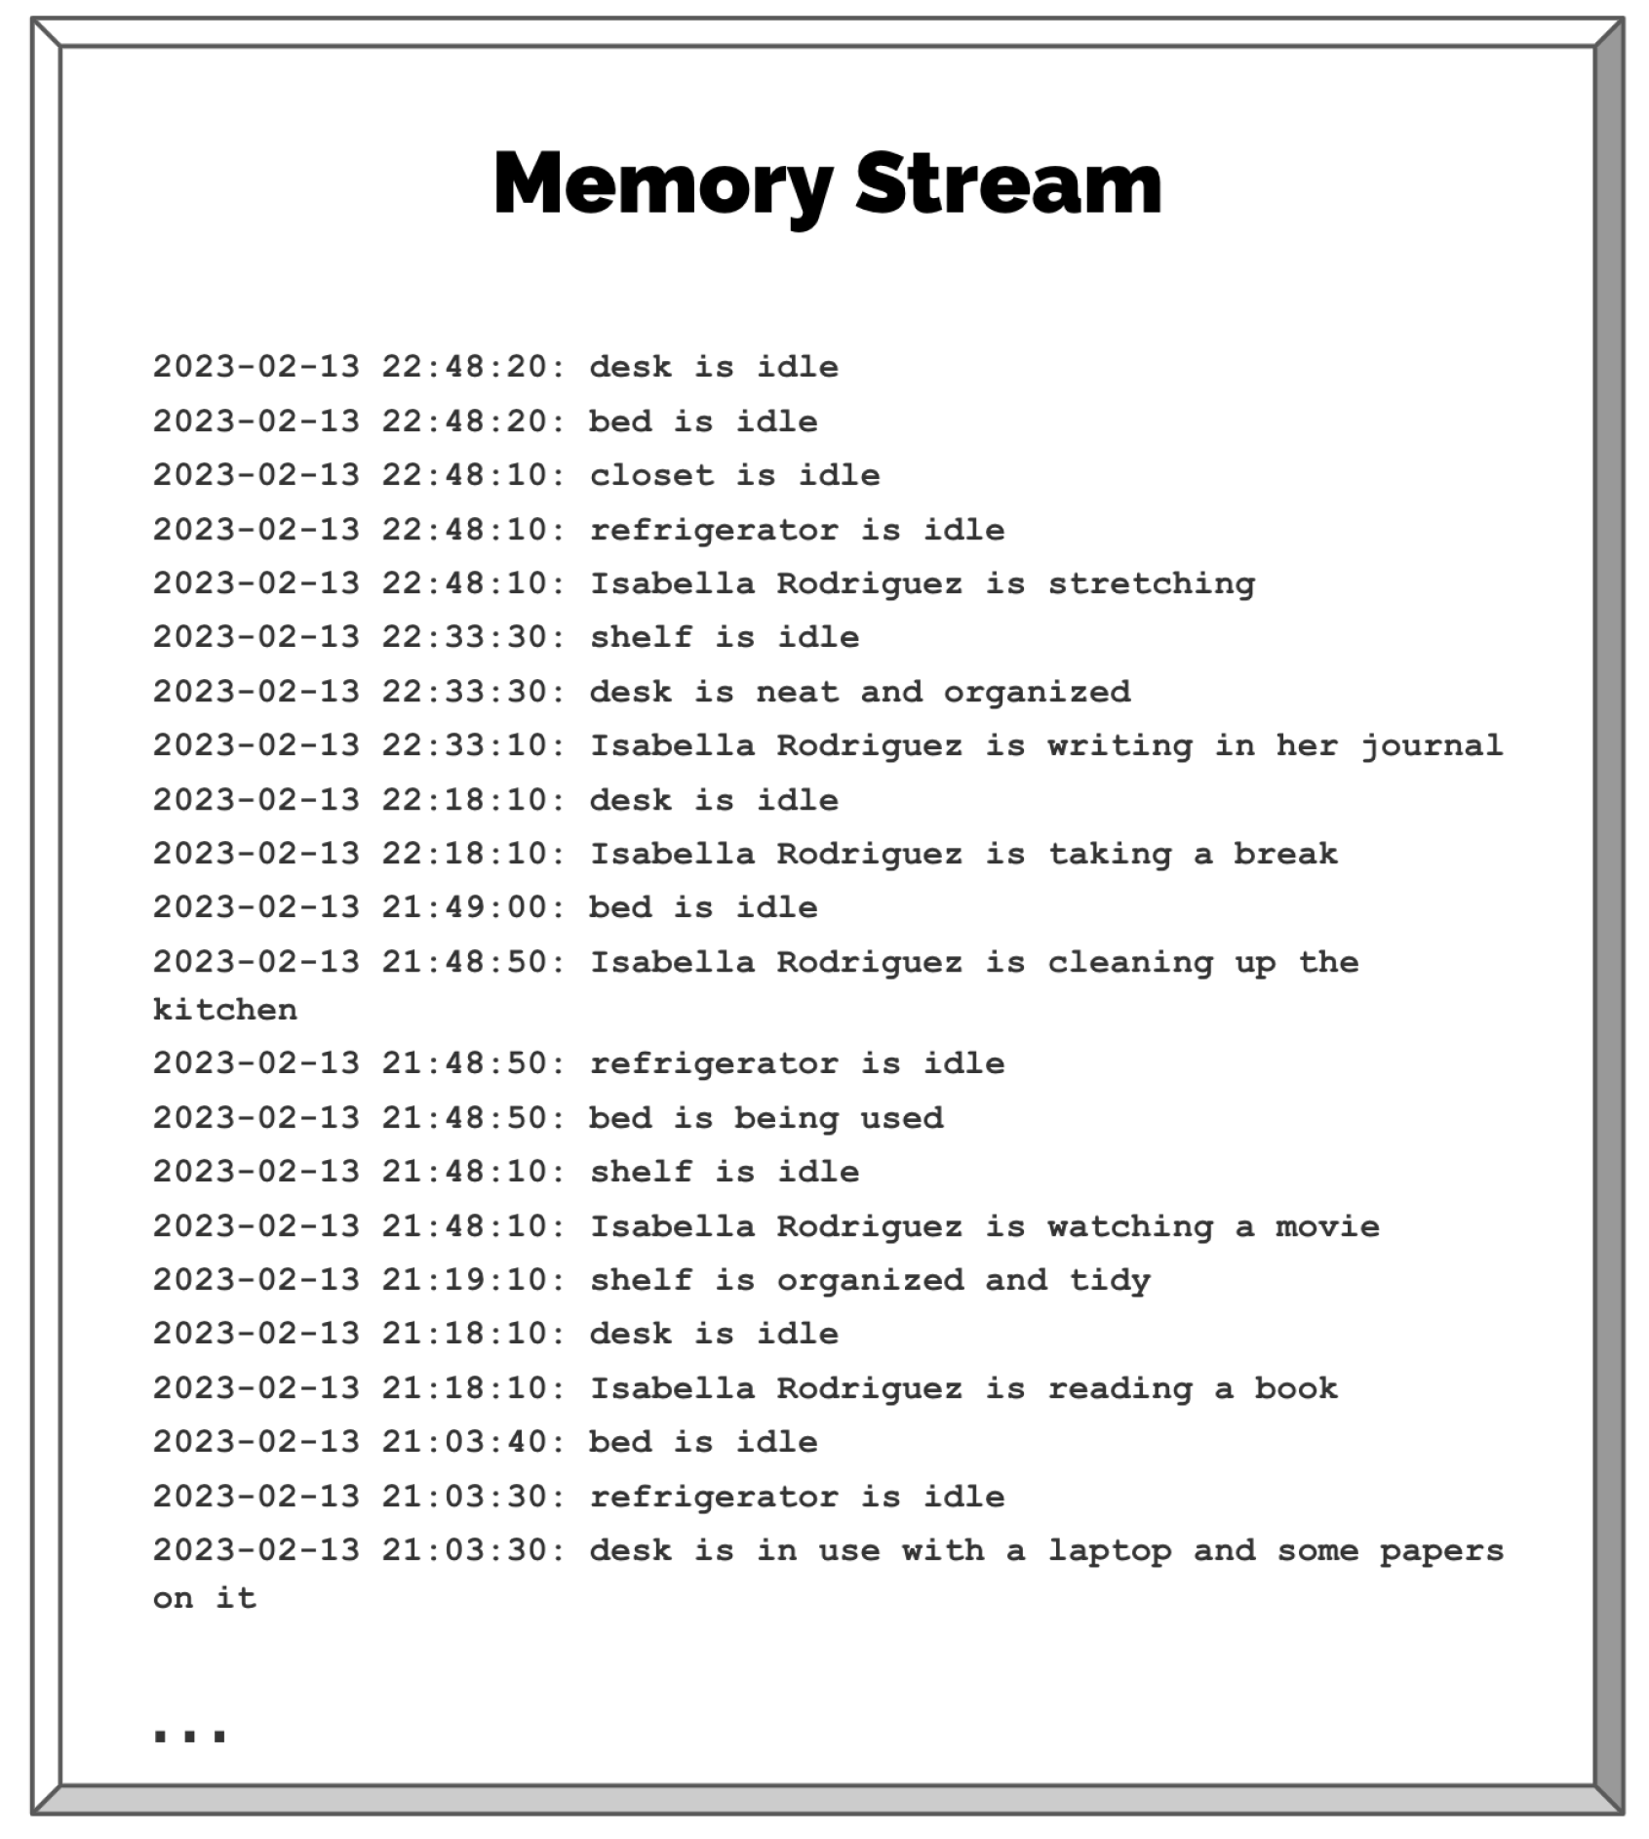
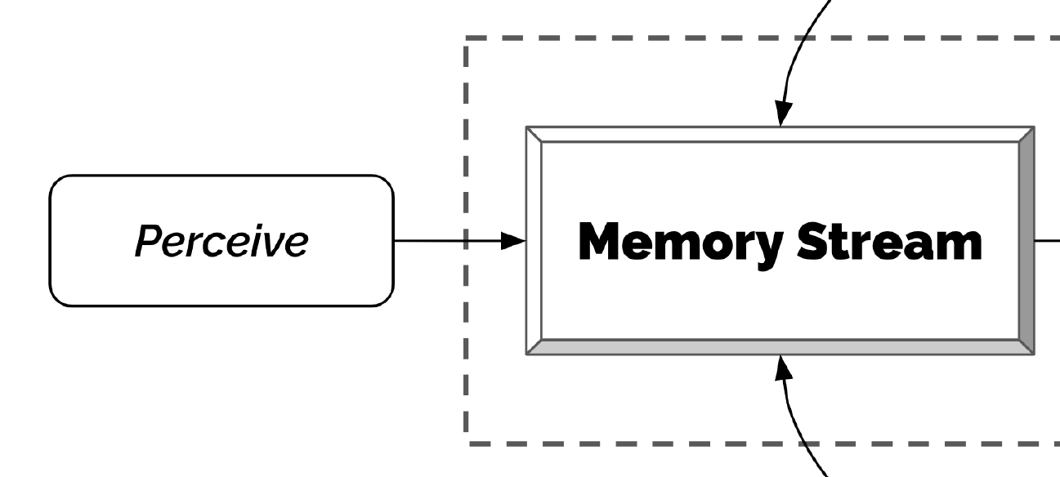
Each observation: GPT score (1-10) importance
1: Brushing teeth
10: break up

Slide 15
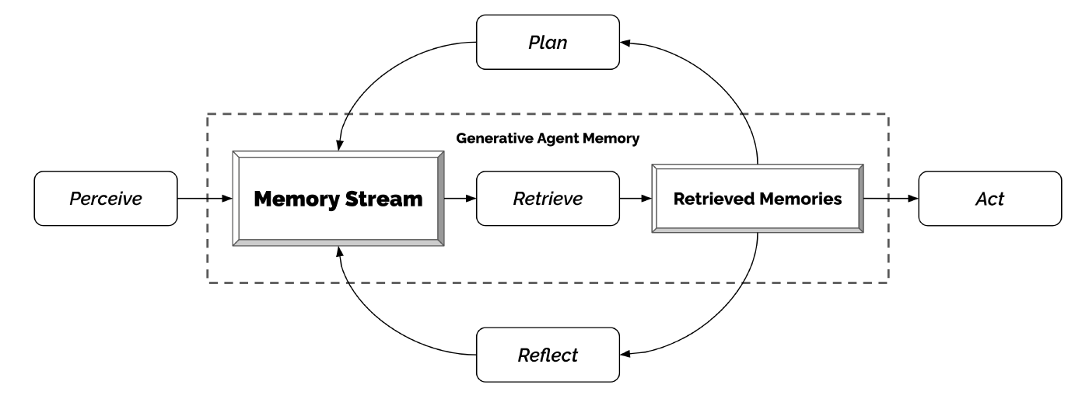
Retrieving memories

Slide 16
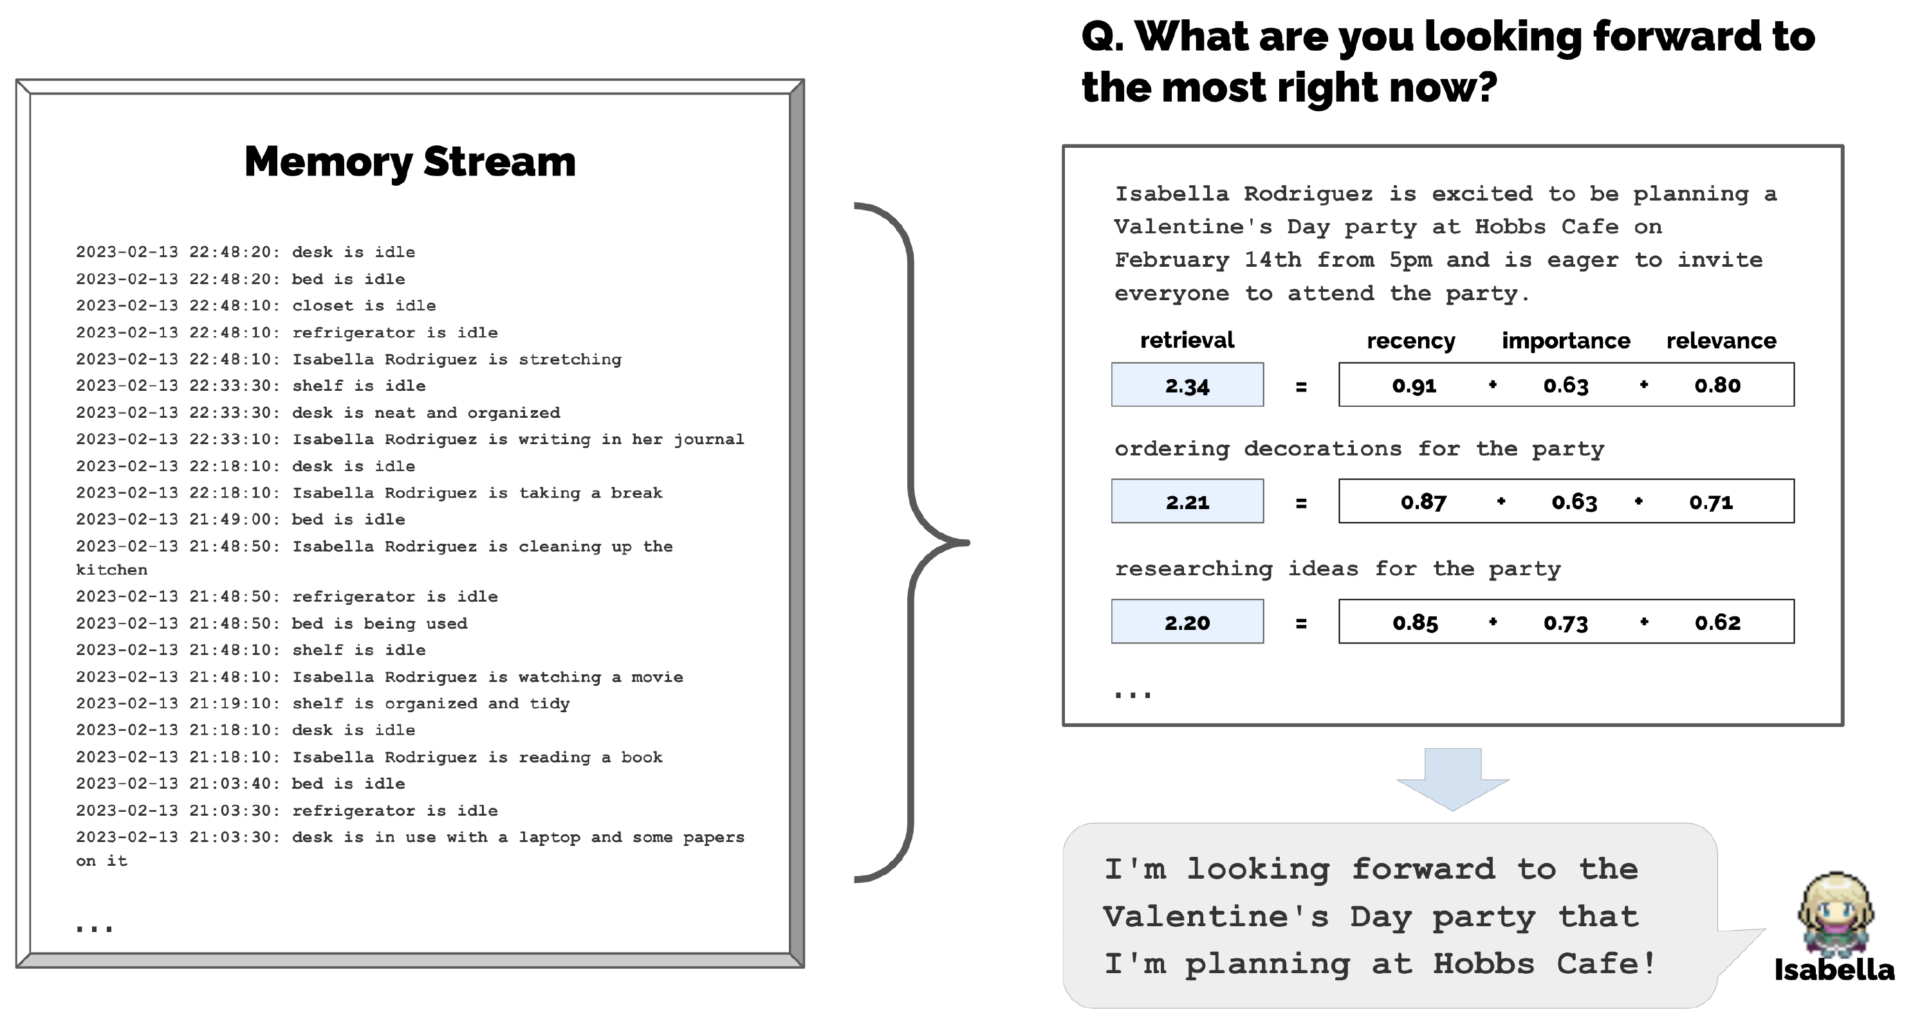
Compaare qn with memories via vectors for relevance score

Slide 17
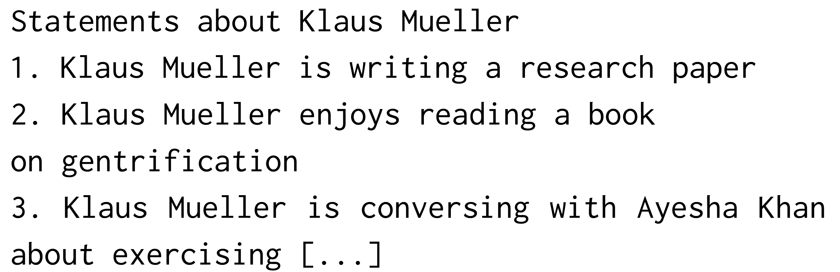
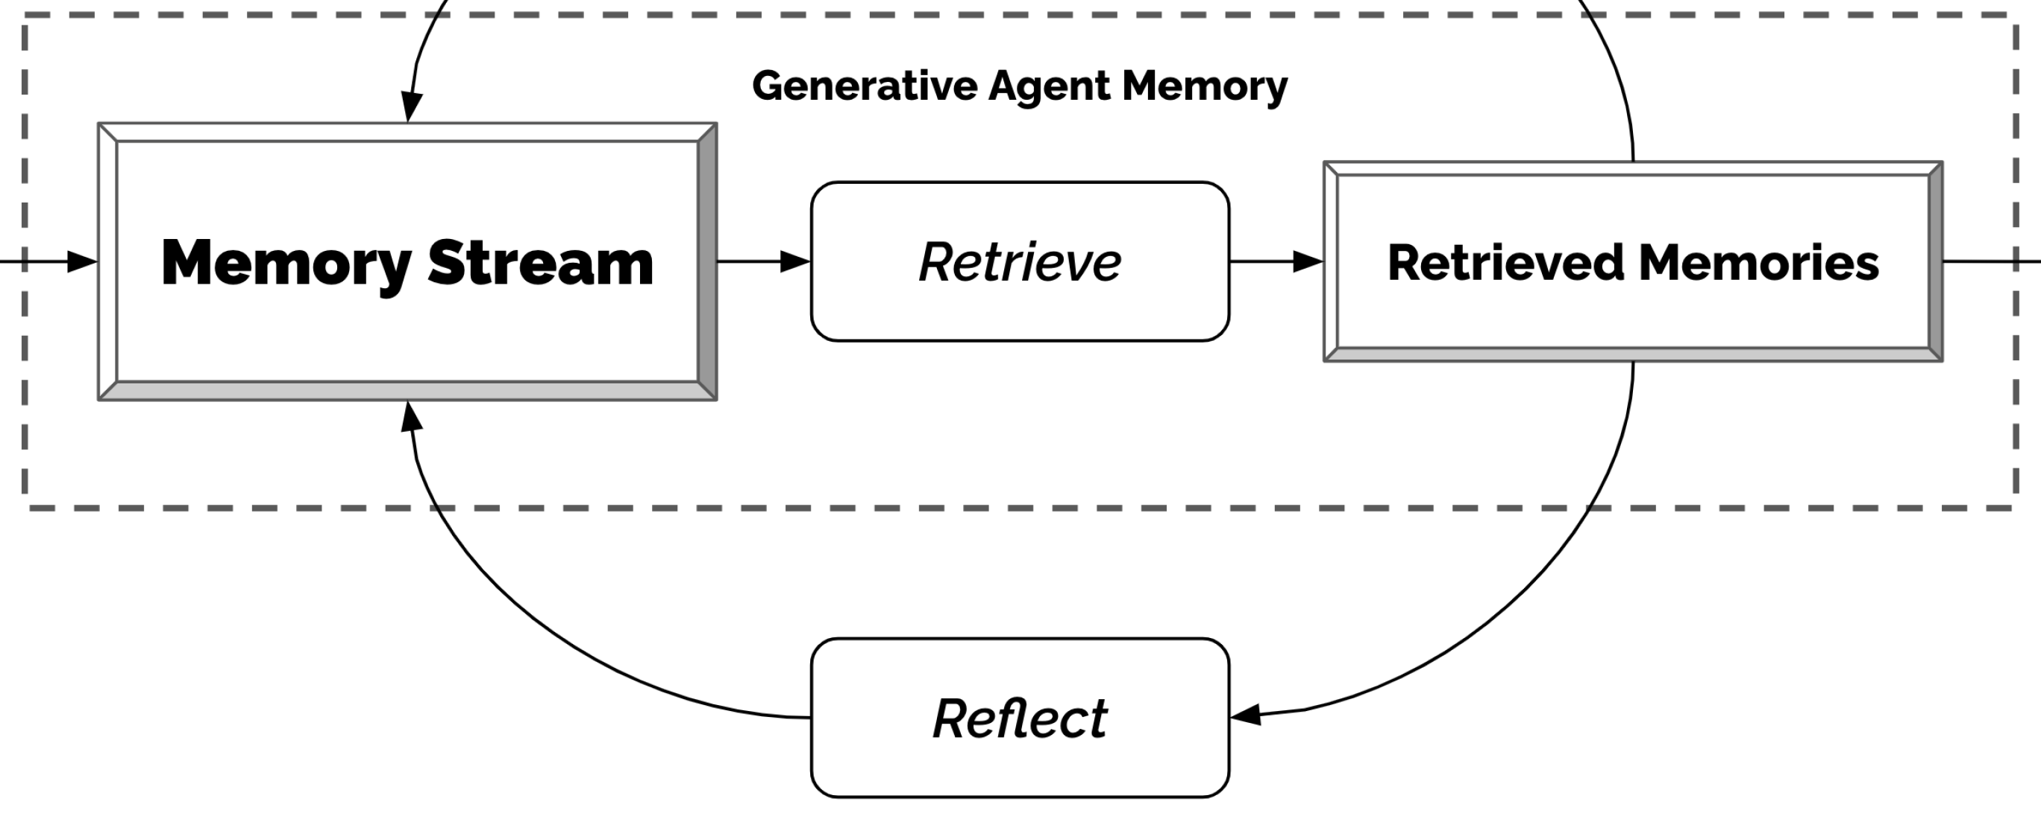
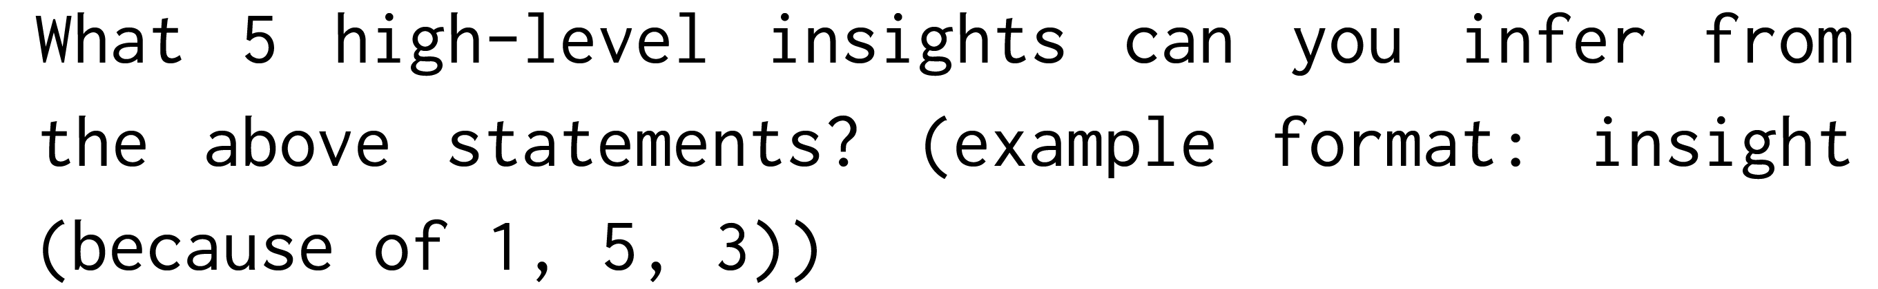
Reflecting
Triggered when many ‘important’ events accumulated!
2. Ask GPT: Top 3 qns reflect on?
3. Use the 3 qns to retrieve related memories
Q1: What topic is Klaus passionate about?
Q2: What is the relationship between…
Q3: …
1. Pull 100 most recent records
4. Ask GPT to extract insights and cite evidence
Klaus Mueller is dedicated to his research on gentrification (because of 1, 2, 8, 15).

Slide 18
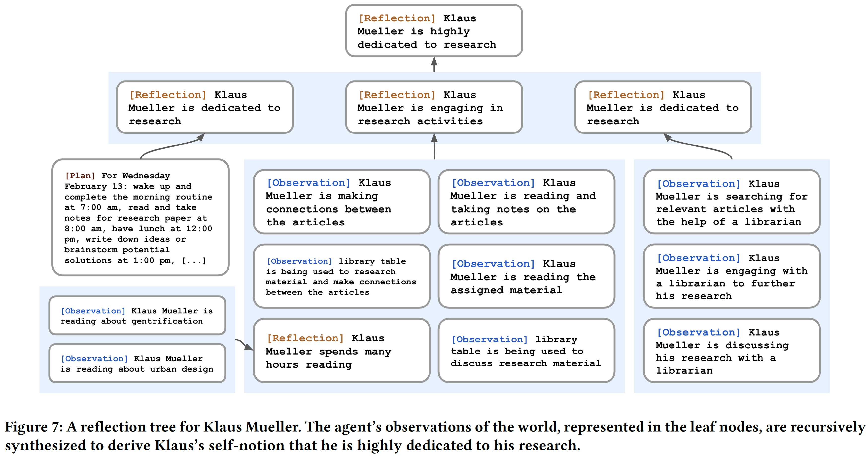

Slide 19
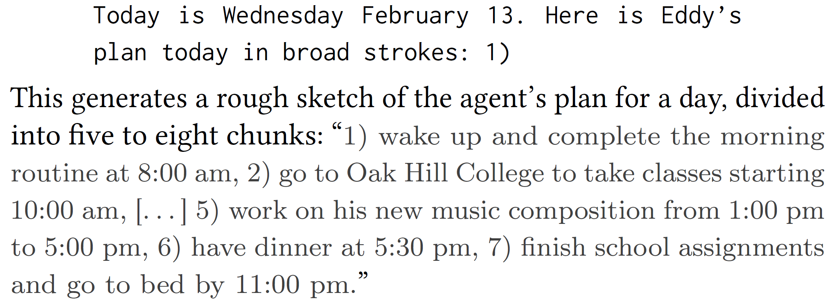
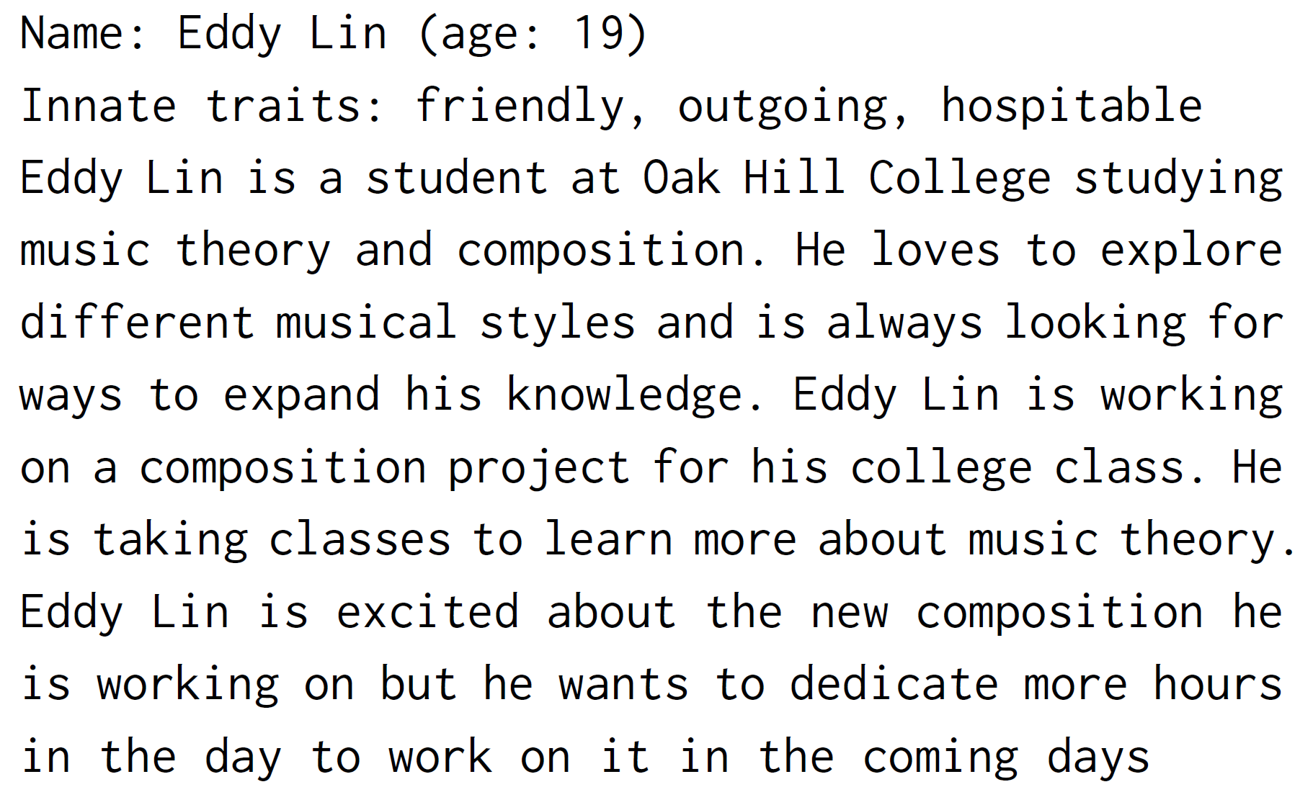
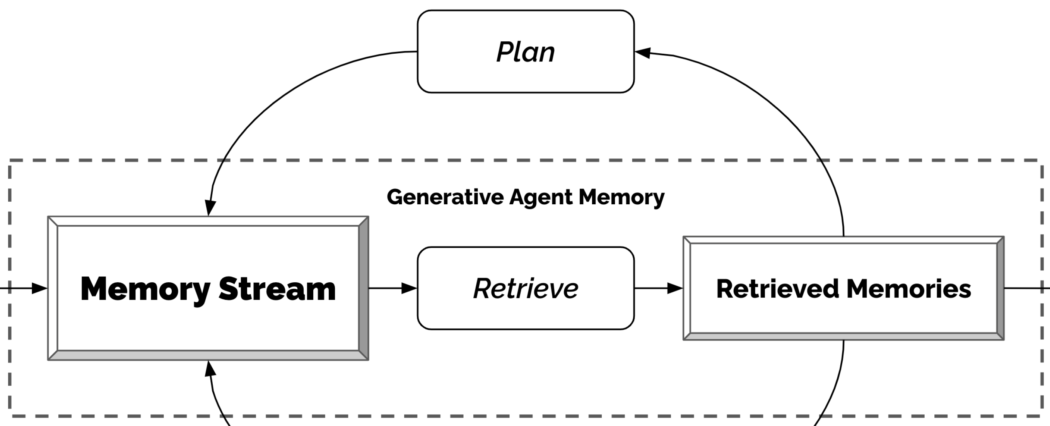
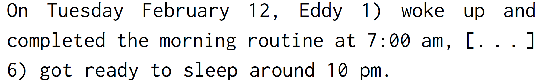
Daily Planning
+ finer planning eg 5 min chunks
“Knowledge”
“Experience / POV”

Slide 20
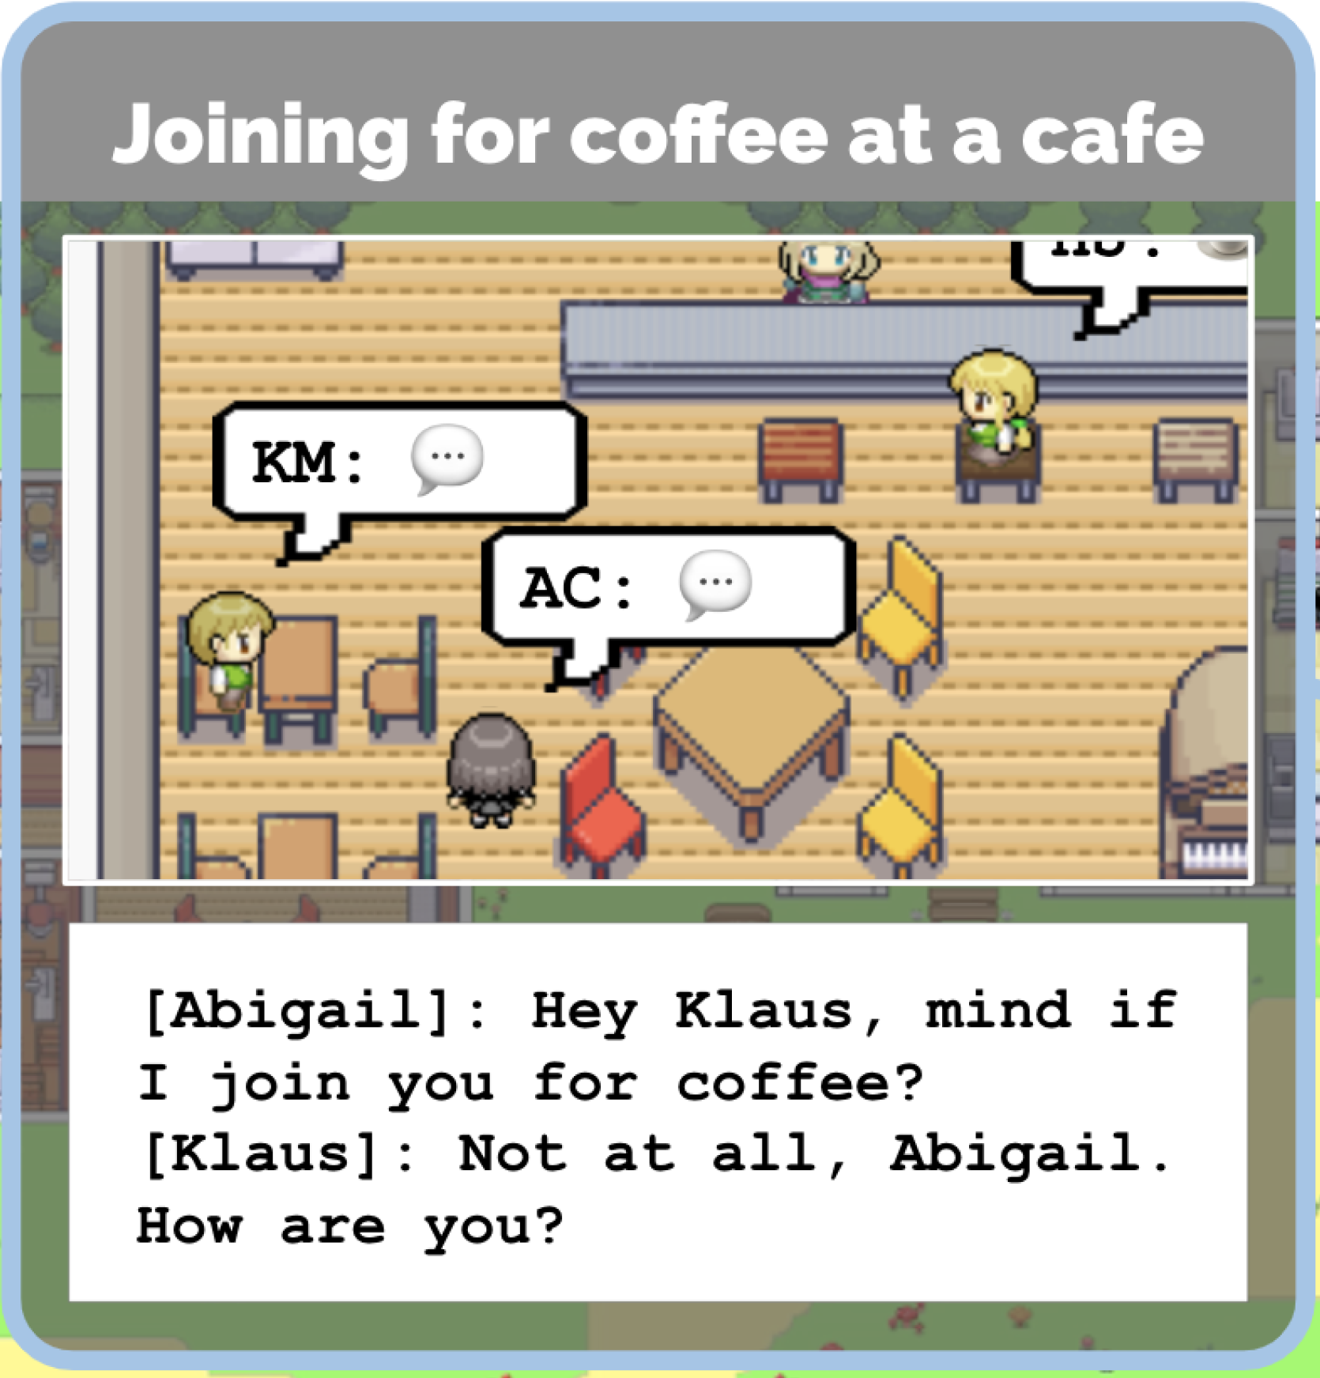
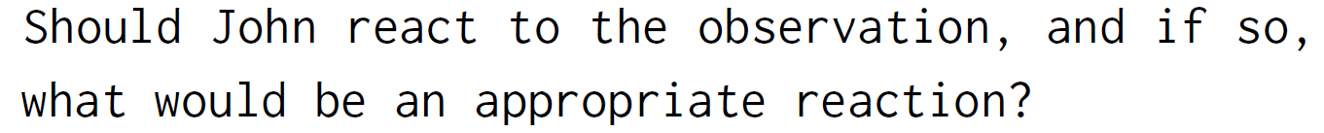
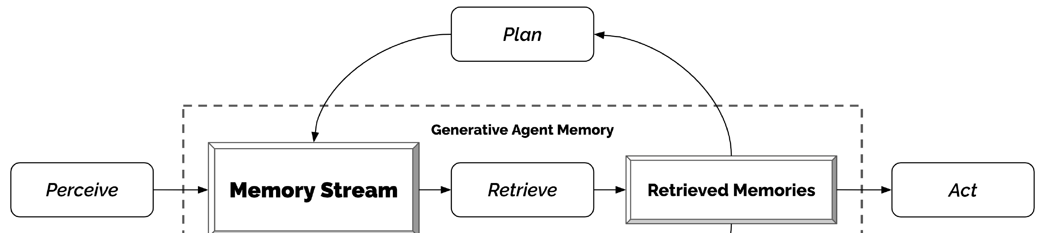
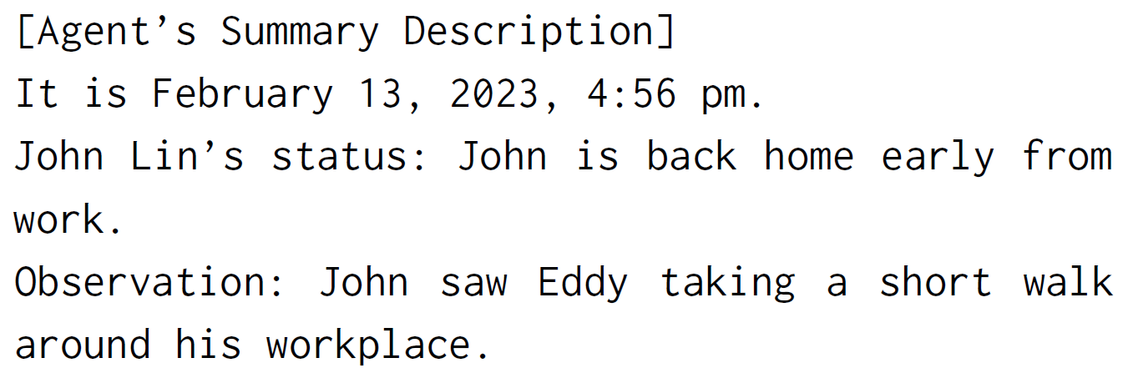
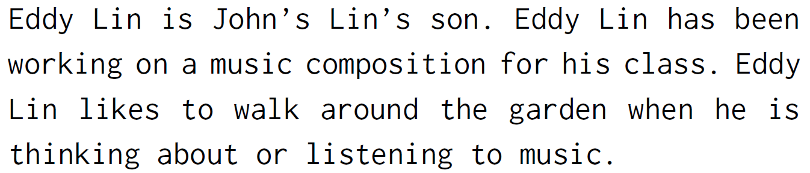
Planning + Reacting
3.
Change plan! “John could consider asking Eddy about his music composition project.”
1.
4.
2.
5.

Slide 21
Other Advancements in AI x Games

Slide 22
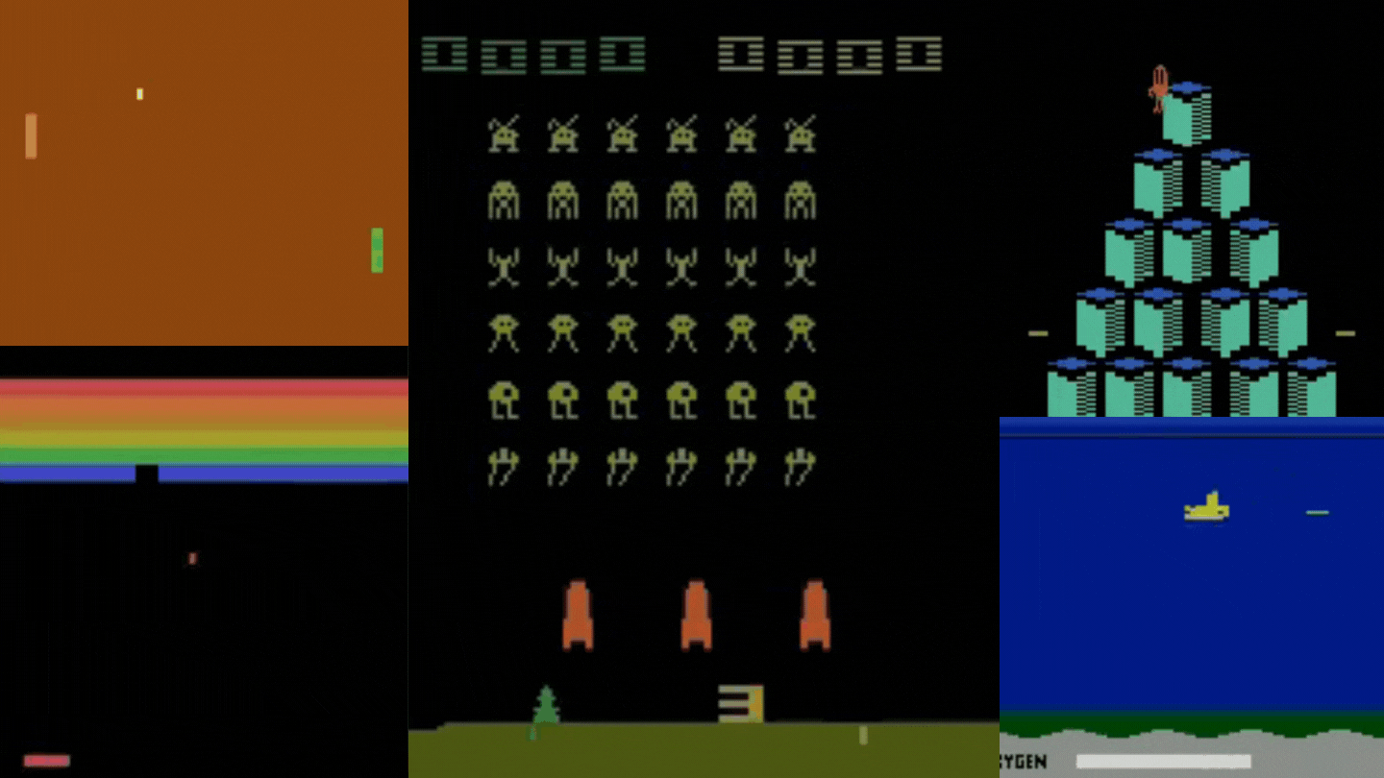
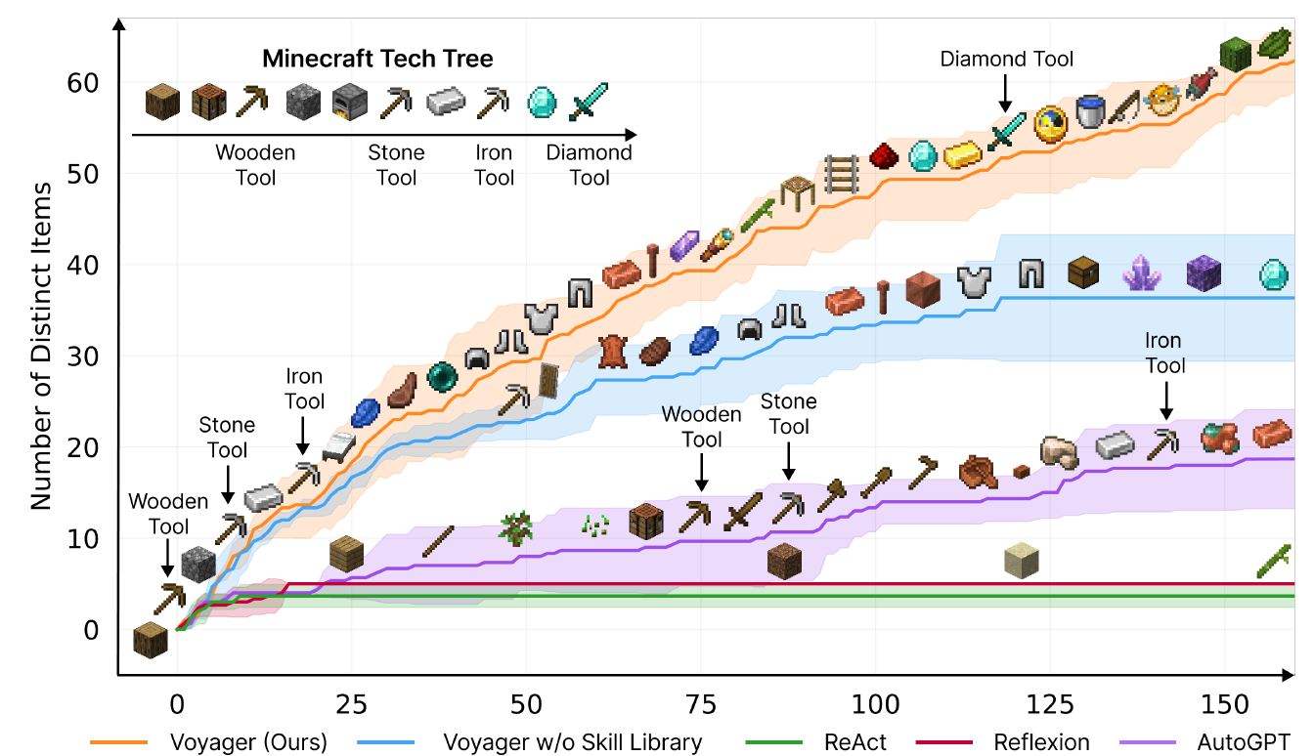
Existing Knowledge + Build Skills for Bots
Previous: Learn from scratch
Write + reuse code
Learn from external source!
Wang, G., Xie, Y., Jiang, Y., Mandlekar, A., Xiao, C., Zhu, Y., Fan, L. and Anandkumar, A., 2023. Voyager: An open-ended embodied agent with large language models. arXiv preprint arXiv:2305.16291.
https://huggingface.co/learn/deep-rl-course/unit3/introduction

Slide 23
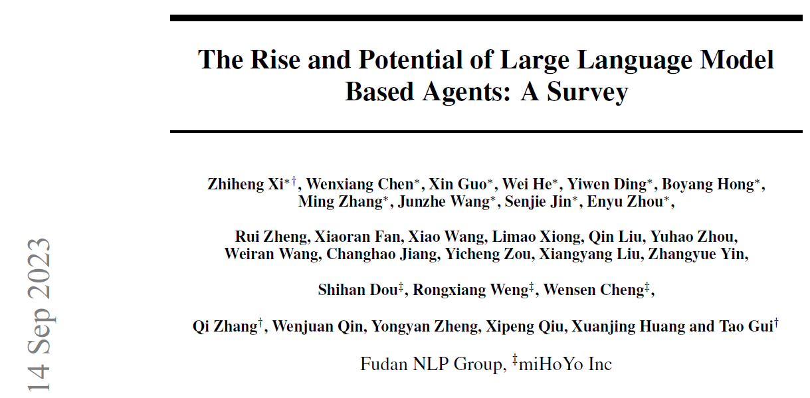
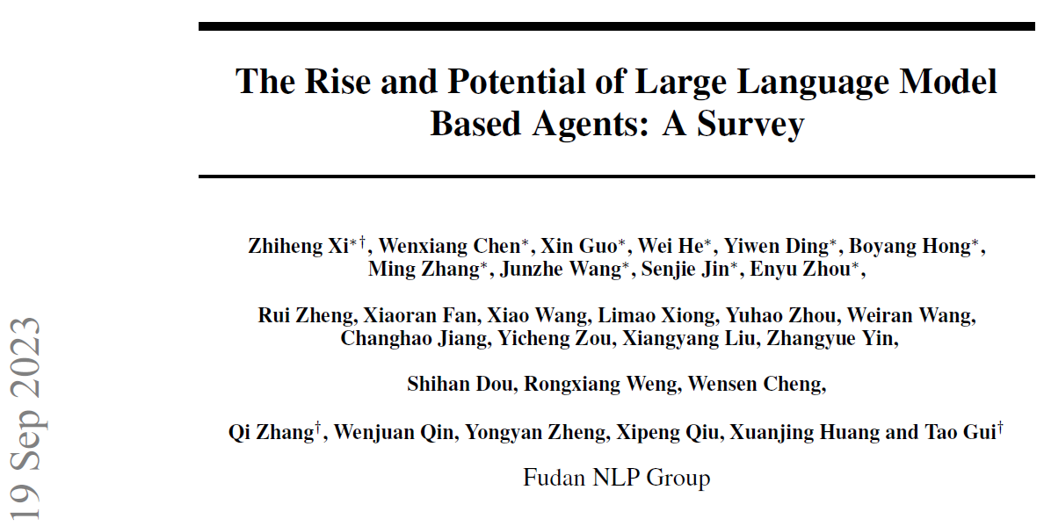
Industry Interest?

Slide 24
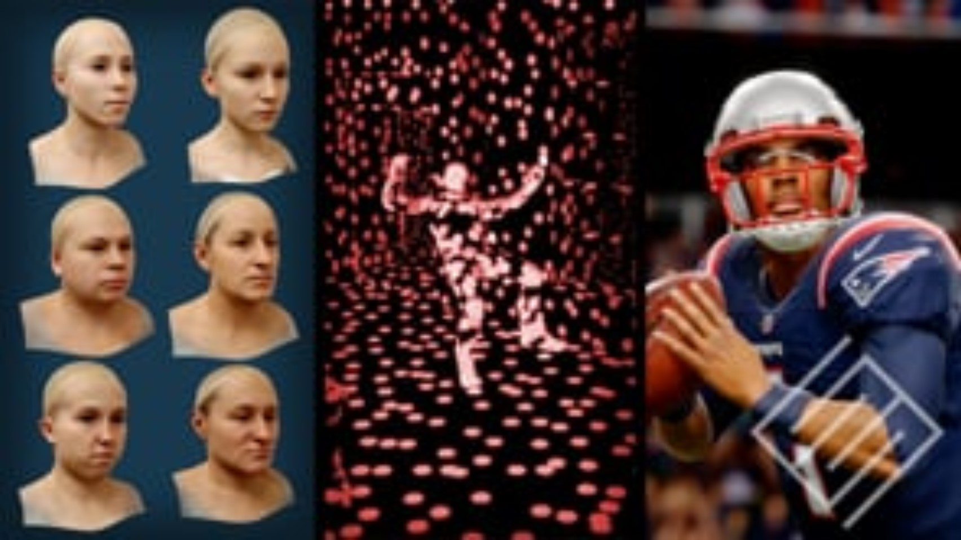
Industry Interest 2
https://www.ea.com/seed/news/seed-greatest-hits

Slide 25

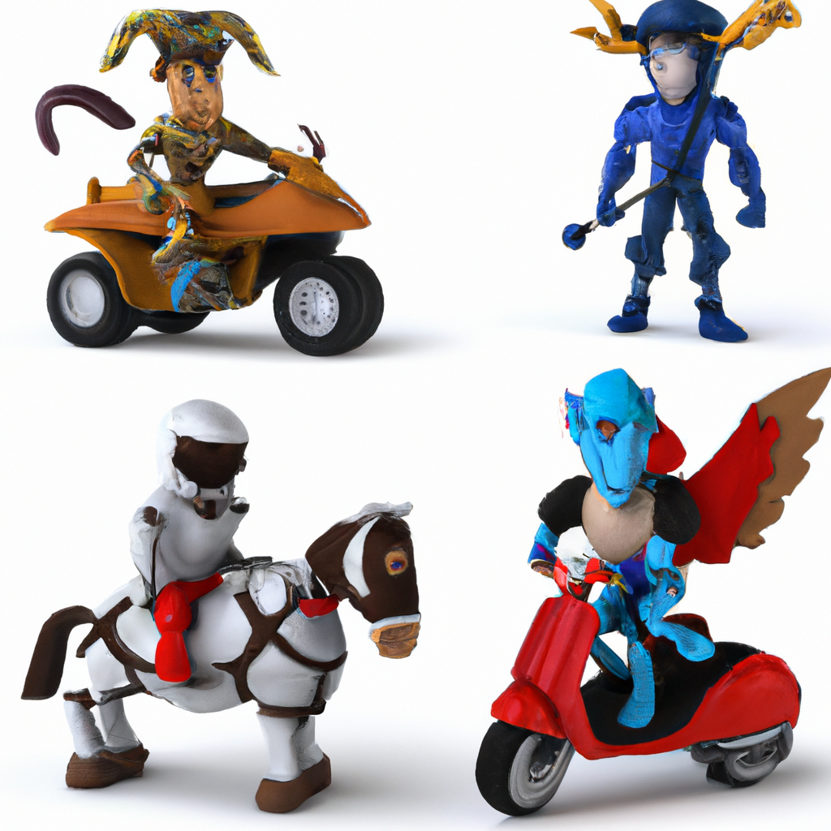
Enhancing the game experience 2
Game design / mechanics
Economic simulation + Game balance
Difficulty level tailored to user!
Adaptive game characters (strategy)

Slide 26

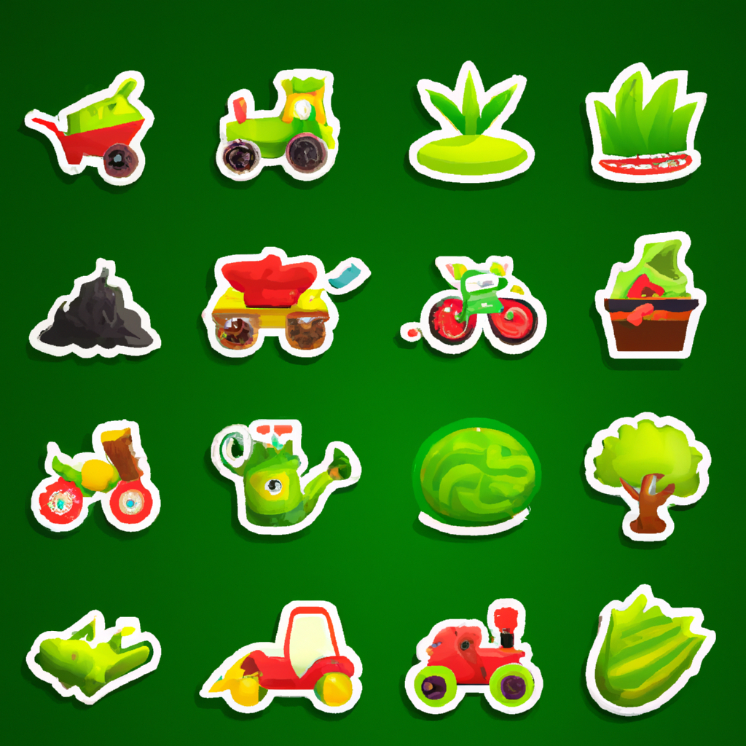
Discussion
Believable personalities + game skill: Botted engagement/ item farming?
Safeguards

Slide 27
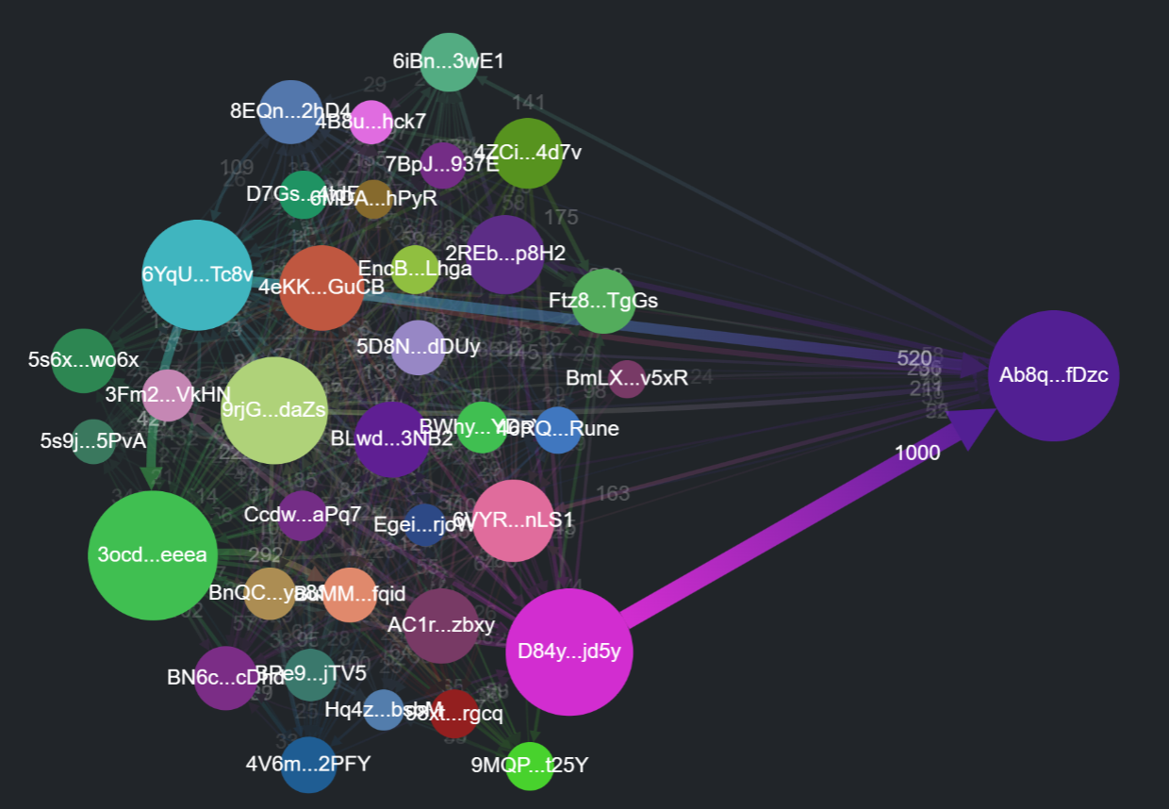

Get Involved + Q&A
Light-touch AI / Data advisory for open-source web 3 projects
Details, extra AI x Game resources, slide downloads here:
Previous hackathon: Network analytics (aka bubble charts?) for wash trading detection

